Slide 1
Report on Pizza Sales

Slide 2
Table of Contents
1.Project Overview
2.Project Objectives
3. Tools and Technologies Used
4. Data Source
5. Data Preparation Process
6. Data Transformation
7. Dashboard Overview
8. Dashboard Visualizations
9. Key Business Insights
10. Business Recommendations
11. Project Conclusion

Slide 3
Project Overview
The Pizza Sales Analysis Dashboard is an interactive Business Intelligence solution developed in Microsoft Power BI to analyze pizza sales performance during the period January 2015 to December 2015. The dashboard provides management with a comprehensive view of revenue, order trends, customer purchasing behavior, product performance, and sales distribution across categories and sizes.
The primary purpose of this project is to transform raw transactional sales data into actionable insights that support data-driven decision-making, improve operational efficiency, and identify growth opportunities.

Slide 4
2. Project Objectives
Analyze overall sales performance of the pizza business.
Monitor revenue and order trends over time.
Identify peak sales days and business hours.
Evaluate performance of pizza categories and sizes.
Discover best-selling and least-selling products.
Track customer ordering patterns.
Support strategic business decisions through visual analytics.
Business Goals
Increase overall revenue.
Improve inventory planning.
Optimize staffing during peak hours.
Focus marketing efforts on high-performing products.
Enhance customer satisfaction through better product offerings.

Slide 5
3.Tools and Technologies Used
• Power BI Desktop and Power BI Service
• SSMS (SQL Server Management Studio)
• MySQL Server
• DAX (Data Analysis Expressions)

Slide 6
4. Data Source
Dataset Information
The dataset consists of pizza sales transactions containing:
Order ID
Order Date
Order Time
Pizza Name
Pizza Category
Pizza Size
Quantity Sold
Unit Price
Total Price
Source Type
CSV / Excel Files

Slide 7
5. Data Preparation Process
Data preparation was performed using Power Query Editor.
Data Cleaning Activities
1. Removed duplicate records
2. Handled missing/null values
3. Standardized date formats
4. Corrected data types
5.Removed unnecessary columns
6. Validated sales calculations

Slide 8
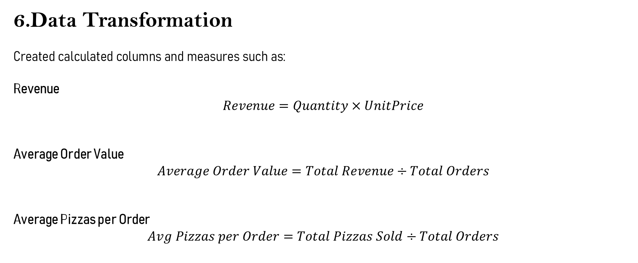
6.Data Transformation
Created calculated columns and measures such as:
Revenue
$$Revenue=Quantity×UnitPrice$$
Average Order Value
$$Average Order Value=Total Revenue÷Total Orders$$
Average Pizzas per Order
$$Avg Pizzas per Order=Total Pizzas Sold÷Total Orders$$

Slide 9
7. Dashboard Overview
The dashboard provides a complete overview of pizza sales performance through KPIs and visualizations.
Key Performance Indicators (KPIs)
1.Total Revenue - $817.86K
2.Average Order Value - $38.31
3.Total Pizza Sold - 49,574
4.Total Orders - 21,350
5.Average Pizza Per Order - 2.32

Slide 10
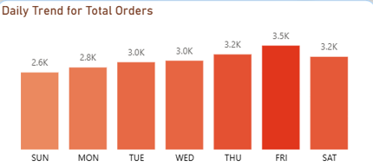
8. Dashboard Visualizations
A. Daily Trend for Total Orders
Displays order volume across weekdays.
Insights
Friday recorded the highest number of orders (3.5K).
Thursday and Saturday also showed strong demand.
Sunday had the lowest order volume.
Business Recommendation
Increase staffing and inventory during weekends and evenings.

Slide 11
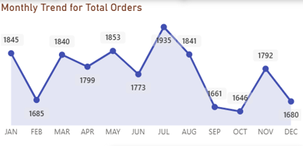
B. Monthly Trend for Total Orders
Shows monthly order fluctuations throughout the year.
Insights
July recorded the highest orders (1,935).
January and August also showed strong performance.
October had the lowest order volume.
Business Recommendation
Launch promotional campaigns during low-performing months.

Slide 12
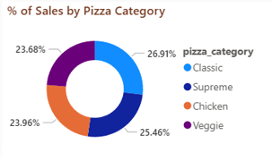
C. Sales Distribution by Pizza Category
Categories analyzed:
Classic
Supreme
Chicken
Veggie
Insights
Category Sales Constribution
Classic 26.91%
Supreme 25.46%
Chicken 23.96%
Veggie 23.68%
Key Finding
Classic pizzas generated the highest share of sales.

Slide 13
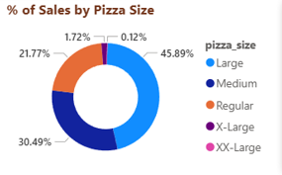
D. Sales Distribution by Pizza Size
Insights Contribution
Large 45.89%
Medium 30.49%
Regular 21.77%
X-Large 1.72%
XX-Large 0.12%
Key Finding
Large-sized pizzas are the most preferred by customers.

Slide 14
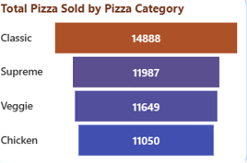
E. Total Pizzas Sold by Category
Category Quantity sold
Classic 14,888
Supreme 11,987
Veggie 11,649
Chicken 11,050
Key Finding
Classic Pizza Category is the top-selling category.

Slide 15
9. Key Business Insights
Customer Behavior
Customers prefer ordering during weekends.
Evening periods generate maximum sales.
Average customer purchases approximately 2 pizzas per order.
Product Performance
Classic pizzas dominate sales volume.
Large-sized pizzas contribute nearly half of total sales.
Supreme and Veggie categories maintain consistent demand.
Seasonal Trends
July is the strongest sales month.
October experiences a noticeable decline in orders.
Sales remain relatively stable throughout the year.

Slide 16
10. Business Recommendations
Revenue Growth
Promote high-margin Classic pizzas.
Introduce combo offers featuring Large pizzas.
Inventory Optimization
Maintain higher stock levels for top-selling categories.
Reduce inventory for low-demand XL and XXL sizes.
Marketing Strategy
Run promotional campaigns during September and October.
Launch weekend-focused marketing offers.
Operational Efficiency
Schedule additional staff on Fridays and Saturdays.
Improve delivery capacity during peak hours.

Slide 17
11. Project Conclusion
The Pizza Sales Dashboard successfully converts raw sales data into meaningful business insights. The analysis reveals that Classic pizzas and Large sizes are the major revenue drivers, while weekends and evenings generate the highest customer demand. By leveraging these insights, management can optimize inventory, improve staffing, enhance marketing effectiveness, and ultimately increase profitability and customer satisfaction.
Overall Outcome: The dashboard serves as a powerful decision-support tool for monitoring sales performance and driving business growth.

Slide 18
Thank You
Questions & Answers

